Slide 1
Edunet Hackathon
in collaboration with
IBM SkillsBuild on IBM Bob

Slide 2



Team : FloodGuard AI
Institute : Parul University
Project: Project: FloodGuard AI – Agentic AI-Powered Urban Flood Intelligence & Disaster Response System
“A Gujarat-built solution for a Gujarat problem”
Need of Project: Urban flooding in Ahmedabad and Surat is intensified by heavy rainfall, drainage constraints, low-lying areas and delayed civic response. FloodGuard AI provides early flood-risk intelligence by combining weather data, ML predictions, drainage information and citizen reports to generate explainable and prioritized response recommendations.
Prince Jain
Methodology
• Collect rainfall, weather, drainage, historical flood and citizen-report data.
• Use ML to predict zone-level flood risk.
• AI agents analyze risk, drainage, citizen reports and response needs.
• Evidence Fusion combines signals to prioritize high-risk zones.
• AI generates response recommendations with Human-in-the-Loop approval
Conclusion and Demonstration
FloodGuard AI transforms urban flood data into actionable decision intelligence.
Weather & Citizen Reports → ML Risk Prediction → Multi-Agent Analysis → Evidence Fusion → Zone Prioritization → AI Response Recommendation → Human Approval → Audit Trail
The system enables explainable, prioritized and data-driven civic response.
Alka Raikwar
IBM TOOLS USED
  IBM Bob – AI-assisted development
  IBM Granite – AI reasoning & recommendations
  IBM watsonx – Granite AI integration
  IBM Cloud – Cloud infrastructure
  Agentic AI – Multi-agent workflow
  Machine Learning – Flood-risk prediction
“FloodGuard AI doesn't just predict flooding — it converts evidence into prioritized action.”
Aniket Jaiswal

Slide 3
Development with IBM Bob
1 REQUIREMENTS
2 BOB CREATES PLAN
3 REVIEW & REFINE
Defined FloodGuard AI’s urban flooding problem, functional requirements, six-agent architecture, data inputs and expected outcomes with IBM Bob.
Used Bob to analyze the existing codebase and plan the implementation of ML prediction, agent workflows, dashboard modules and AI-assisted decision support.
Reviewed Bob’s proposed approach as a team, refined requirements and protected the existing architecture before implementation.
4 CODE GENERATION
5 REVIEW OUTPUT
6 RUN & VALIDATE
Bob assisted in implementing Python/Streamlit components, ML workflows, agent logic, UI modules and supporting application functionality.
Team-reviewed Bob-assisted changes for correctness, integration, usability and consistency with FloodGuard AI’s six-agent architecture.
Ran the application and validated flood-risk prediction, weather inputs, citizen reports, dashboard workflows and AI-generated recommendations.
7 BOB EXPLAINS
8 QUALITY & TESTS
9 DOCUMENTATION
Used Bob to understand existing modules, implementation decisions, code relationships and the reasoning behind development changes.
Used iterative review and testing to identify issues, validate edge cases and improve the reliability of application and AI workflows.
Used Bob to support technical documentation, code explanations, project understanding and preparation of development evidence.
IBM Bob assisted the FloodGuard AI team across the SDLC; the team reviewed, refined, validated and approved each implementation.

Slide 4
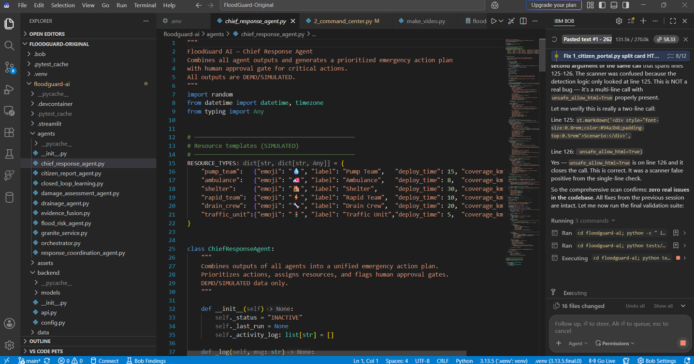
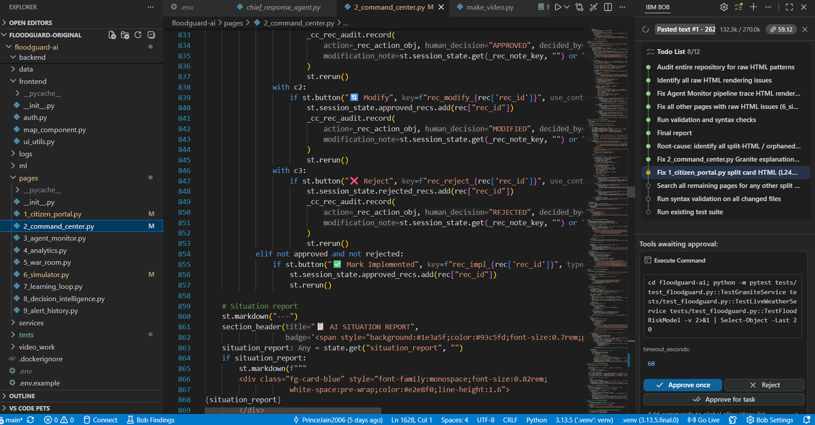
IBM Bob — FloodGuard AI Development
IBM Bob — FloodGuard AI Project Structure
IBM Bob — FloodGuard AI Code Generation
Screenshot: FloodGuard AI project structure showing Streamlit application files, AI agents, ML modules, dashboard components and configuration.
Screenshot: IBM Bob assisting with ML flood-risk prediction, AI-agent workflows and Streamlit dashboard components

Slide 5
Key Features of FloodGuard AI
MULTI-AGENT AI SYSTEM
FLOOD RISK PREDICTION
CITIZEN FLOOD REPORTING
Multiple specialized AI agents collaborate through an orchestrated workflow to analyze flood risk, drainage conditions, citizen reports and civic response requirements.
ML models analyze rainfall, weather and historical flood indicators to identify and predict zone-level flood risk for early decision support.
Citizen-submitted reports provide ground-level evidence about flooding, affected areas and severity, helping the system improve situational awareness.
DRAINAGE PRIORITIZATION
EVIDENCE FUSION
Combines flood-risk information, drainage conditions and reported incidents to identify drainage issues and prioritize areas requiring attention.
Combines weather signals, ML predictions, drainage information and citizen evidence to prioritize high-risk zones with explainable reasoning.
RISK-TO-ACTION INTELLIGENCE
FloodGuard AI goes beyond flood prediction by combining multiple evidence sources to generate explainable, prioritized and actionable response intelligence.
Converts prioritized flood risks into actionable AI recommendations for civic response, with Human-in-the-Loop approval for critical decisions.

Slide 6
Novelty & Future Scope
NOVELTY & UNIQUENESS
FUTURE SCOPE
Multi-Agent Flood Intelligence
Real-Time Sensor Integration
Multiple specialized agents collaborate to analyze flood risk, drainage, citizen reports and civic response requirements.
Connect live water-level, rainfall and drainage sensors to strengthen real-time flood monitoring and prediction.
Evidence-Based Risk Prioritization
Advanced Flood Forecasting
Combines ML predictions, weather signals, drainage information and citizen evidence to identify high-risk zones.
Improve prediction using larger historical datasets, real-time weather feeds and advanced ML models.
Explainable AI Recommendations
GIS-Based Flood Intelligence
Provides reasons behind risk prioritization and generates understandable response recommendations instead of only giving predictions.
Expand geospatial analysis to provide more detailed flood-risk maps, drainage hotspots and affected-zone visualization.
Human-in-the-Loop Response
Scalable Civic Response Platform
AI recommendations are reviewed by humans before critical actions, keeping decision-making under civic authority.
Extend FloodGuard AI to more flood-prone cities and integrate with civic response teams for faster incident coordination.
Future Vision: From Predictive Flood Intelligence to Real-Time, Explainable and Coordinated Urban Response.

